Slide 1
Your Career Story in Capgemini
Where can my career go from here?

Slide 2
Take Control of Your Career
Great things never come from comfort zones
Make each day your masterpiece
Be successful, Be disruptive, Embrace opportunities
Action is the foundation key to all success

Slide 3
Your Career Story in Capgemini
Career Framework
Growing @ Capgemini
Performance Management
Meet your Partners
Talent Management
Learning & Development
Our Six Dimensions of Leadership
For you to use & Appendix

Slide 4


Your Journey with us
We value our people. In particular, we believe in three things:
You should
Grow
You Own
your Career
No
One Way
Notes:
– Our people should grow: building your skills, your abilities, your ambitions is important – when you benefit, we benefit
– You own your career: we’ll provide you with the tools and framework, but it’s up to you to drive it
– There’s no ‘one way’: we’ll give you the opportunity to take your career in the direction you want.

Slide 5

Your career can be like a jungle gym.
Career framework –
the foundation of your journey
at Capgemini
It helps you to own your aspirations and motivations for what you want to do professionally. It means you can be clear on what you do, how you fit in and what you need to do to progress.
Notes:
The framework relies on:
Roles
Grades
Competency models
Promotion criteria
It defines and describes your role, ensuring you understand the competencies you need to succeed in it, the grade you’re at now and what you need to achieve to take the next step in your career.
The Career Framework is like a GPS for your career.

Slide 6
Career Framework: Roles>Competencies>Proficiencies>Learning Maps Direct Link: https://careerframework.fs.capgemini.com/
To view your Role, go to iConnect → Employee Management → Career Framework.
1
Click your Role to view the role description, competencies, and proficiencies for each competency.
2
Click Courses to explore the Learning Journeys aligned to the competencies required for your role.
3
Your Role
Register for and complete the Learning Programs mapped to the Learning Journeys.
4
Software Consultant Lead
To track your learning completions, go to Track Your Journey→ Learning Health Index.
5
For queries, please email talent.fssbu@capgemini.com

Slide 7
Performance Management

Slide 8


Challenge yourself.
Grow at Capgemini.
Build a career
As we adapt to take the opportunities disruption offers us, you have a big opportunity too – to embrace a career, not just a job.
Executive VP
F2
Business Unit/Practice Leader/Function Leader
F
Vice President
F1
Senior Director
E2
Client Partner/Account Exec
E
Director
E1
Account Manager
Portfolio Manager
D2
D
Senior Manager
D1
Engagement Manager
Manager
C2
Project Manager
C
Senior Consultant
C1
Team Leader
Consultant
B2
Team Member
B
Associate Consultant
B1
Senior Software Engineer
A5
A
Software Engineer
A4
Software Associate
A3
Global Grade
Designation
Indicative
Roles

Slide 9





Get to know your People Manager/Appraiser
You must
There are some basic roles that a People Manager plays:
Set-up a meeting with your PM
Solutions
Enabler
Helps the Employee:
Apply new skills and knowledge
Learn from their experiences
Performance & Development Strategist
Ensures the Employee:
Knows performance evaluation criteria
Has development plans
Acquires needed knowledge and skills
Prep well when having formal meetings with your PM
When not staffed ask your PM for contacts, to help with work that may lead to a project
Opportunity Broker
Helps the Employee:
Identify development opportunities in their current role and beyond.
Honest
Appraiser
Appraises Employees:
On the job performance
Progress against their Development Plan.
Notes:
Set-up a meeting with your PM to discuss specific topics (projects, performance feedback, etc.)
Be prepared when having formal meetings with your PM (what are your objectives from the meeting)
When not staffed ask your PM for contacts, to help with work that may lead to a project

Slide 10

Set-up time to meet your People Manager.
Set aside time to meet.
Discuss your career progression
so far.
Discuss your aspirations and roles available to progress.
Agree on critical competencies and performance standards defined in the Career Framework.
Discuss strengths and perceived areas of development that are critical to success.
Co-create your development plan. Finalize on MyPath (performance mgmt. system)
Decide how you will track and report progress.
Follow through and make progress visible.
Ask for feedback regularly.
1
2
3
4
5
6
7
8
9

Slide 11
Excels Significantly and consistently exceeds most/all performance criteria/expectations for the level. Unique, exceptional accomplishments clearly obvious to all. This rating is reserved for those individuals whose performance is consistently far above what is usually expected from an individual at the level. Generally the best performance that can realistically be expected - Outstanding Performance and Contribution.
Exceeds Consistently exceeds many/most of the performance criteria/expectations for the level. Typically achieved by only the best of experienced performers. Performance is noticeably better than expected. Results consistently exceed expectations of an individual at this level - Distinguished Performance and Contribution.
Rating Scale
Attains / Succeeds Consistently meets all and periodically exceeds some of the performance criteria established for the level. Results are achieved for an individual at the level. Steady, reliable contribution - Commendable Performance and Contributions.
Needs Improvement Meets some but not all of the performance criteria established for the level. Results are usually achievable, although some areas need improvement. With proper training and guidance, an individual should be able to meet all expectations in a reasonable time frame - Provisional Performance and Contribution.
Needs Significant Improvement Fails to meet the minimum performance criteria established for the level. Unsatisfactory results. Immediate and substantial improvement needed to continue employment in current level - Unacceptable Performance and Contribution.
Notes:
Emphasize that 3 is really good.

Slide 12
Talent Management Our approach to talent management starts from performance management to developing talent further based on needs…
Diagnostic
Talent View
Development & Key Outcomes
Performance Management
Talent Management
Learning & Development
05
Promotions to next leadership grade
04
Development plans for the High Perf. / High Pot. + dynamic reporting and follow-up, stretch goals
03
Identification of Potential (High, Medium, Low)
02
Strategic Talent Reviews for Directors, Sr. Directors & VPs
01
Talent Reviews for Managers, Senior Managers & Portfolio Mgrs.
Notes:
Please mention we use a tool for Talent Management.
Talent Management
Diagnostics
Assessments using multiple lenses for identification of Top Talent
Development through structured Learning journeys
Action Learning projects
Mentoring
Skill Building
Role & Competency Models
Career Framework Tool with 91 roles defined (Core, professional & Role-based competencies, Learning Maps)
Internal growth opportunities via IJP
Infusion of young talent from Business schools
Regular Talent reviews for Talent visibility and actions
Succession Planning for Key roles

Slide 13
Performance Management Cycle
Mid-Year
Reviews
Year-end
Review Begins
Year-end
Review Complete
Objective Setting
June - July
August – September
October – November
November - December
January-February
February - March
April - May
First Assignment Appraisal due
Mid Year Reviews completed (non VP only)
Employees continue working to satisfy their performance objectives
Training for Year End Reviews
Second Assignment Appraisals due
Year End Self Assessments
Provisional Ratings
Calibrations conducted
Year End Reviews Complete
Complete Objectives
Talent Reviews conducted (Grades D-F)
1
2
3
4
Objective Setting/Self-assessment (Employee)
Review / Signoff (Reviewer)
Signoff (Employee)
Process Complete
Performance Reviewer
Add/Edit / Review/Appraise and Signoff
Employee
Enter Objectives/Self-assessment against goals
Sign-off
Process Complete/ Sent to HR for calibration for Annual Appraisal
You must also complete Assignment Reviews on MyPath after every project.
Notes:
They say you get out what you put in. Your contribution to the business helps define our overall success and also your personal success.
Our Performance Management process is designed to help you understand what we expect from you.
Step 1: Objective setting Step 2: Mid-Year Assessment Step 3: End of Year Assessment
You will receive regular feedback on activities which are going well and coaching on areas where you can improve and continue to develop.
At the end of the year you will receive a formal evaluation of your overall performance for the year.
Our aim is to ensure that these reviews are conducted in a spirit of honesty, openness and collaboration.
MyPath is a global tool to support the overall process. It encourages everyone to seek and act upon feedback throughout the performance year.

Slide 14
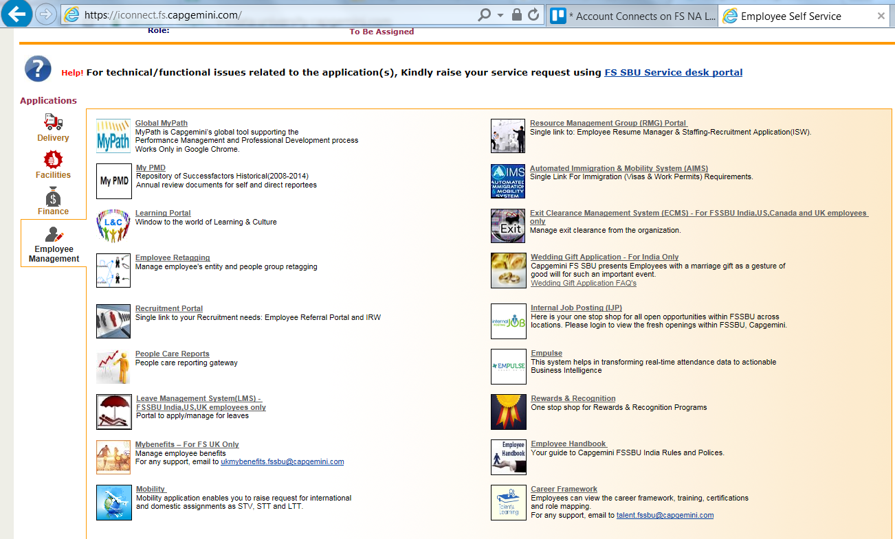
Finding MyPath
2 People
5. Log in

Slide 15
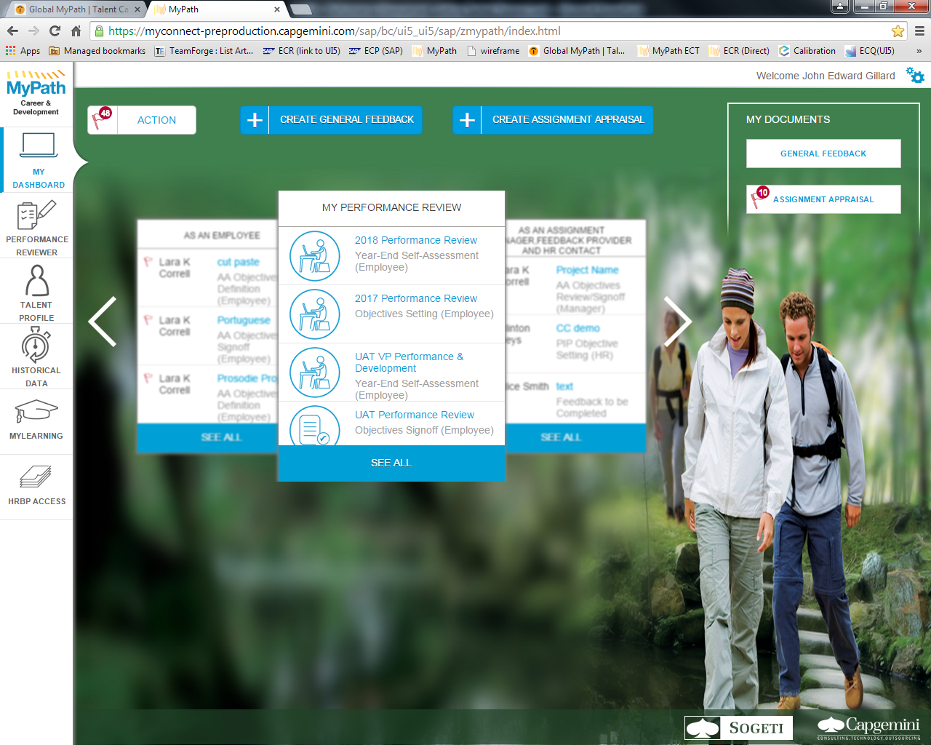
Demo:

Slide 16
Objective Setting: Steps
Add / Modify Objectives
Objectives can be added or modified during Mid-Year by the employee/reviewer under individual section
Employee gets as opportunity to sign off and complete the objective setting after discussion with reviewer
Performance Reviewer
Add/Edit Objectives
and Signoff
Employee
Enter Objectives
Review Objective
Objective Setting Complete
**No validation on sum of KPI weightings

Slide 17
Mid Year Assessment
In line with the global and industry practice there will be enhanced focus on feedback
Alignment to objectives changed or added in the mid year review will be important
1
2
3
4
Mid Year Self Assessment (Employee)
Mid Year Assessment Signoff (Reviewer)
Mid Year Signoff (Employee)
Mid Year Complete
Performance Reviewer
Update Mid Year Comments and edit /add Mid Year Objectives
Employee
Enter Mid Year Comments and edit /add Mid Year Objectives
Accept Mid Year Comments
Mid Year Complete
Attachment
**Please note at any stage of the performance document where ever the action is pending on the reviewer or the employee, the document will move to the next stage after a defined period.
Both employee & reviewer can upload

Slide 18
Year End Assessment
Rating –
KPI wise comments to be entered
In self assessment employee provides comments on KPIs
In Reviewer evaluation manager provides comments on KPIs and one holistic rating
Calibration –
Employee view the feedback comments and calibrated rating after calibration, only after Reviewer gives “Final Signoff”
1
2
3
4
5
6
Year End Self Assessment (Employee)
Year End Assessment (Reviewer)
Year End Signoff (Reviewer)
Year End Signoff (Employee)
Year End Complete
Calibration (HR)
Performance Reviewer
Preliminary Comments
Final Comments
Employee
Input Year End Self Assessment comments
Accept Comments
Year End Complete
HR
Conduct calibration.
**Please note at any stage of the performance document where ever the action is pending on the reviewer or the employee, the document will move to the next stage after a defined period.

Slide 19

Assignment Appraisals
1
2
3
4
AA Objectives Definition (Employee)
AA Objective Review Signoff (Manager)
AA Objective Signoff (Employee)
(In Review)
Assignment Manager
Add/Edit Objectives
and Signoff
Employee
Create Assignment Objectives
Accept Assignment Objectives
Objective Setting Complete

Slide 20
Requesting and Giving Feedback
1
2
Create Feedback
Complete Feedback
Feedback Provider
Create Feedback
Give Feedback
Feedback Complete
Employee
Create Feedback
General Feedback
Any employee can provide or seek feedback from any other employee.

Slide 21


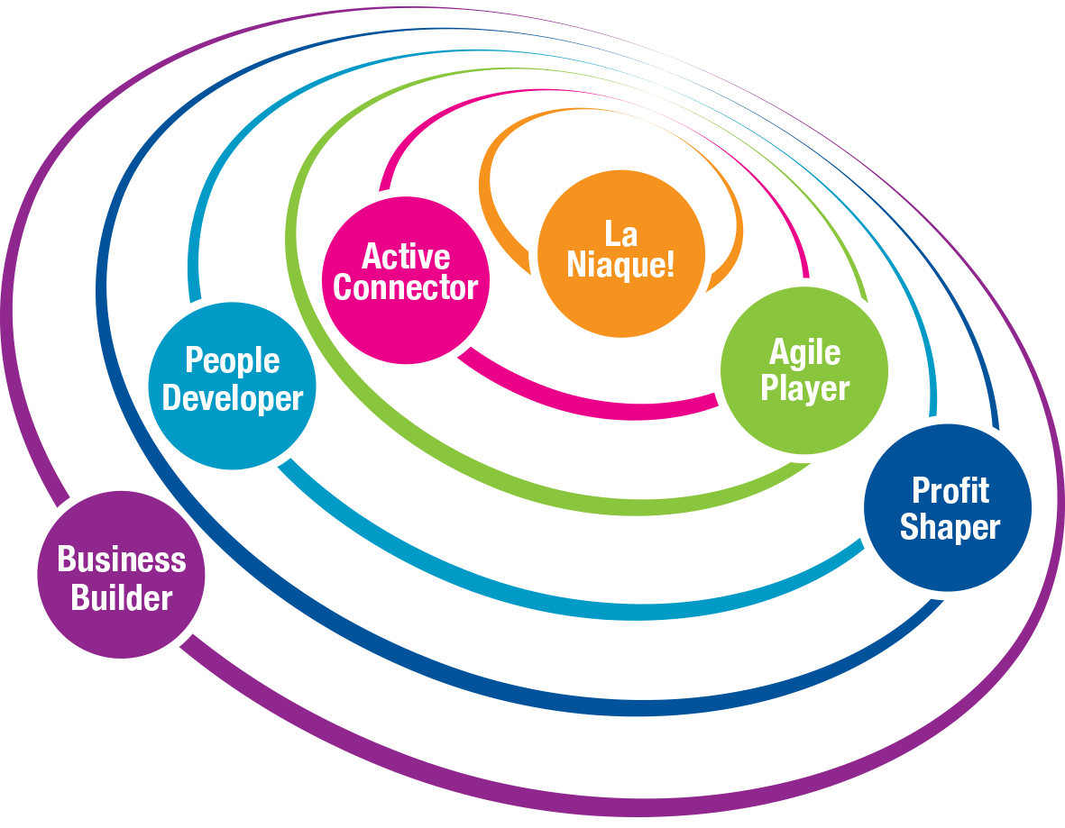
Six Dimensions: A Leadership model to drive your actions
Six Dimensions:
A leadership model to drive your actions
Notes:
At Capgemini – at every grade, on every assignment, you need to demonstrate leadership. It’s how we harness the energy of disruption.
Our leadership model has six building blocks, requiring you to be a: Business builder, Profit shaper, People developer, Active connector, Agile player and show our special quality of La Niaque.

Slide 22
The FS World is divided into what we call Practices
Banking Diversified Financials (BDF)
Capital Markets (CM)
Application Development Management (ADM) – ERP also included
Testing
Insurance (Ins)
Global Lead – Carlos Salta
NA Lead – Michael Donnary
NA HR – Michael Nardi
NA Staffing – Pulkit Mehrotra
NA Learning – Sinjini Bandyopadhyay
Global Lead – Ferreol DeNauris
NA Lead – Peter Katsos
NA HR – Michael Nardi
NA Staffing – Ompi Mitra
NA Learning – Sinjini Bandyopadhyay
Global Lead – Abhaya Gupta
NA Lead – Ravi Gandla
NA HR – Bill Grish
NA Staffing – Sakti Dash
NA Learning – Sinjini Bandyopadhyay
Global Lead – Abhaya Gupta
NA Lead – Kumar Balasubramanian
NA HR – Margo Sanders
NA Staffing – Amit Rane
NA Learning – Sinjini Bandyopadhyay
Global Lead – Ian Campos
NA Lead – Andrew Hood
NA HR – Pijush Chatterjee
NA Staffing – Dinesh Nigam
NA Learning – Sinjini Bandyopadhyay

Slide 23
The FS World is divided into what we call Practices (continued)
Insights & Data (I&D)
Digital (DGTL)
Cards & Payments
Business & IT Transformation - Banking (B&ITT)
Business & IT Transformation - Insurance (B&ITT)
Global Lead – Ramana Bhandaru
NA Lead – Vaibhav Shringarpure
NA HR – Jane Viegas
NA Staffing – Mayuri Chande
NA Learning – Sinjini Bandyopadhyay
Global Lead – Vikrant Karnick
NA Lead – Rene Claudio
NA HR – Carolina Ortiz
NA Staffing – Amit Rane
NA Learning – Sinjini Bandyopadhyay
Global Lead – Jeroen Holscher
NA Lead – Lakshmanan Sundaram
NA HR – Jane Viegas
NA Staffing – Pulkit Mehrotra
NA Learning – Sinjini Bandyopadhyay
Global Lead – Nilesh Vaidya
NA Lead – Eric Anklesaria
NA HR – Michael Nardi
NA Staffing – Ompi Mitra
NA Learning – Sinjini Bandyopadhyay
Global Lead – Nilesh Vaidya
NA Lead – Andrew Hood
NA HR – Pijush Chatterjee
NA Staffing – Dinesh Nigam
NA Learning – Sinjini Bandyopadhyay

Slide 24
Meet your Partners

Slide 25
North America HR Structure
GLOBAL FS C&B FUNCTION
HEAD OF FS SBU HR NORTH AMERICA
& GLOBAL FS SBU HEAD OF C&B
JESUS GOMEZ-MARTINEZ
Lenka Sloman
NA C&B Leader
Sameer Deshmukh
HR Strategist
Priya Choudhary
Diversity
BCM
HRBP Lead
Pijush Chatterjee
Immigration Insurance, B&ITT-Ins
HRBP Lead
Kas Kathir
CANADA
HRBP
Liz Cauffman
Head of NA HR Operations
Maggie Moise
US Benefits
CapGenie
Michael Nardi
BDF, B&ITT-Banking, CM
Bill Grish
SE - ADM, ERP, Duck Creek, Orientation
Ignatius Kumar
HR Operations
Special Projects
Lynne Gomberg
Canada Benefits
Jane Viegas
NE – Tristate
I&D, Cards & Payments,
Support Functions
Margo Sanders
MW – Testing,
Relocations
Purnima Rajesh
Canada Ops/
HRBP Non-FS Canada
Michael Nardi
I-9, HR Files & EVL
Members of the Global FS C&B Function
Carolina Ortiz
Digital Practices
Snehal Munde
NA HR Operations (India)
Notes:
Fixar a posicao do titulo – sempre do lado esquerdo.
Sempre que tiver muito texto o coluna deve sempre ser “ narrowed” , se nao fica dificil de ler. Colocar paragrafos no texto.
Linha vertical deve ser mais fina e as pontas NUNCA devem ser arredondadas.

Slide 26
Your Staffing Partners
Name(s)​ | Practice(s)​
Dinesh Nigam –847-287-1065​ | Insurance, B&ITT-Ins, Duck Creek​
Sakti Dash – 201-755-3101​ | ADM, Auto & ERP​
Mayuri Chande​ (email contact is best: mayuri.chande@Capgemini.com) | I&D​
Amit Rane – 224-258-4487​ | Digital & Testing​
Ompi Mitra​ (email contact is best: neha.d.sharma@Capgemini.com) | B&ITT-Banking​, Capital Markets​
Charudatt Bawane (email contact is best: Charudatt.Bawane@Capgemini.com) | Support Functions​
Pulkit Mehrotra​ (email contact is best: pulkit.mehrotra@Capgemini.com) | BDF, Cards & Payments

Slide 27
Staffing Partner Responsibilities:
Track resource demand and map it
to the resource supply
Open demand to recruitment if internal supply cannot fulfill
Ensure correct project allocations to enable time entry
Follow-up with BU/Account to resolve any allocation discrepancies, extensions and roll offs
Notes:
The framework relies on:
Roles
Grades
Competency models
Promotion criteria
It defines and describes your role, ensuring you understand the competencies you need to succeed in it, the grade you’re at now and what you need to achieve to take the next step in your career.
The Career Framework is like a GPS for your career.

Slide 28
Your Learning Team
Name(s) | Role(s)
Amar Shetty | Global Head, L&D FS SBU
Ajinth Sreedharan | Learning Head, All NA
Sinjini Bandyopadhyay | Regional Learning Partner (RLP), FS NA Learning Design Lead, FS SBU
Rajesh M | Learning Coordinator, FSNA
Ramesh Puram | Global Certifications Manager, FS SBU
Satish Sundaram | MyLearning & iCompass Lifeline, FS SBU
Notes:
Pepper, the robot at Les Fontaines

Slide 29
Learning Highlights: Quick Reckoner (The L&D team drives business-to-learning for FS SBU)
40 hours,
40% virtual
Learning Hrs/employee/year
Contribute to Learning
Bronze, Silver, Gold, and Platinum Star
for contribution to
learning initiatives and for facilitation.
Learning
Mix
Technology,
Domain, and Leadership journeys
Learn through Apps
Use SumTotal, HR Genie, FS Insights apps
ONE certification from the pre-approved list is reimbursed in a calendar year.
Certifications
Help our clients
Transform
Agile, DevOps, Digital, Cloud, Big Data, Robotic Process Automation, FinTech (Blockchain, InsurTech…)
Core, Professional,
& Role-based Learning Journeys
for all delivery and sales roles.
LearningMaps

Slide 30
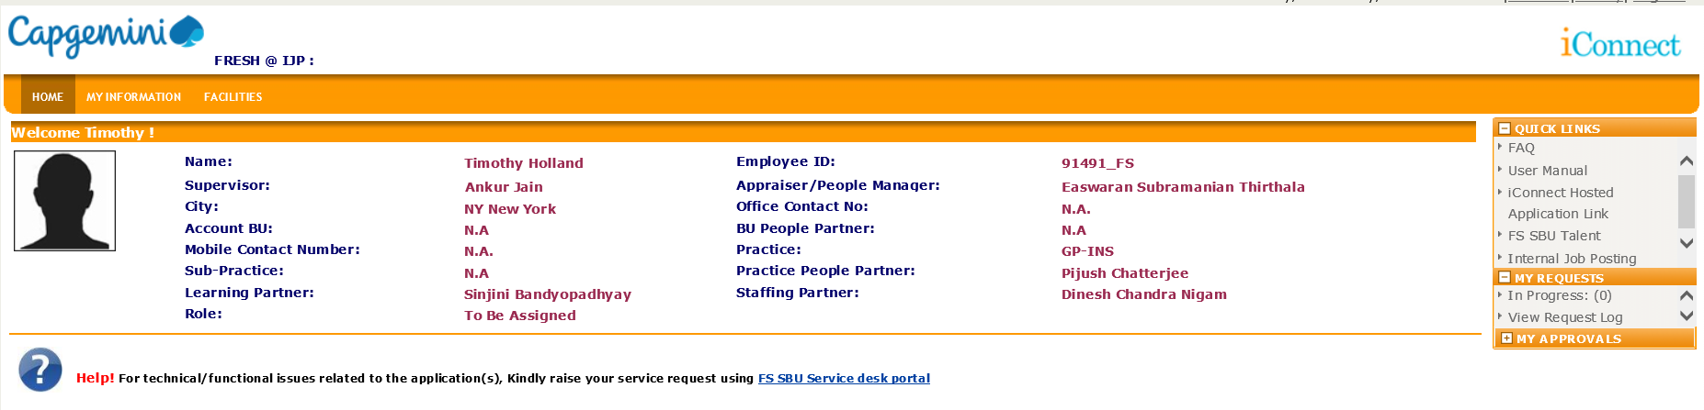
Important Iconnect Fields
Field | Function
Employee ID | You may need this for raising IT tickets, etc
Supervisor | Acts as your team lead. Responsible for timesheets and Leave approvals. This will likely change names as you go from project to project
Appraiser/ People Mgr | Responsible for your yearly performance review. This relationship remains constant even as you move from project to project
Practice | This is how we are aligned in FS. We do not align by BU
People Partner, Learning Partner, Staffing Partner | These support people are assigned to you based on your Practice
Notes:
Key Points:
Approach every situation as an opportunity to sell yourself
Remain professional in all engagements with a client
Consultants need to always “add value”

Slide 31

For you to use
Career Story site
Career Framework
http://careerstory.in.capgemini.com/
Download PDF: http://talent.capgemini.com/media_library/Medias/Common_images/CG_Career_Story_Oct-2016.pdf
https://careerframework.fs.capgemini.com/
HR Page on KM3.0
Other Links
HR - Canada
HR - United States
HR POCs: http://km3.capgemini.com/book/714868
iConnect: https://iconnect.fs.capgemini.com/
MyPath: https://myconnect.capgemini.com
Competitiveness Skill Portal
MyLearning
Employee stories: https://www.capgemini.com/testimonials/

